Slide 1
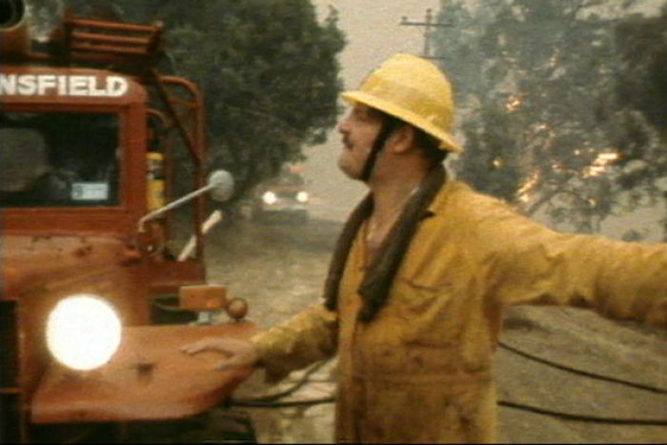
Emergency Service Work Involves Risk
Notes:
Residual funds
In those days...CFA- 14 volunteers died….CFA-funeral, immediate payment...worker’s compensation...things have changed…….AWARENESS that drove that review
Guys like this probably went home and did not talk to anyone…
Inquiry into ash wednesday revealed how poorly these people were cared for

Slide 2
The Emergency Services Foundation
The ESF was founded following the Ash Wednesday Bushfires.
Relieves and assists Victorian emergency service workers and their families who suffer hardship as a result of the worker being engaged in the operations of activities of an emergency service
Funds research aimed at improving methods of relief and assistance or research aimed at lessening the hazards experienced by Victorian emergency service workers in their line of duty
Notes:
Residual funds

Slide 3
Reviewing the Emergency Services Foundation’s Relief and Assistance Program
Advisors: Prof. B. Servatius and Prof H. Servatius Sponsor: Emergency Services Foundation
Manasi Danke, Andrew Kacherski, James Werosta, Ryan Kim
Notes:
- ryan
- we need to explain an IQP here
-explain WPI

Slide 4
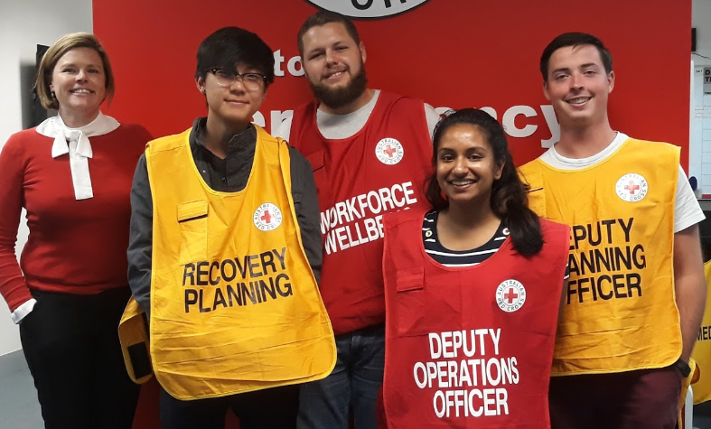
Project Goals
Investigating whether the ESF’s relief and assistance payments are still necessary
What gaps the ESF can fill in hopes of serving and uniting the sector
Notes:
ryan

Slide 5
Project Goals
Talking to Victorian Emergency
Service Organizations
Addressing Support in Place
Finding Gaps in Sector:
Opportunities to Improve
Employees vs. Volunteers
What services are provided to families if worker is injured or deceased
Timeframe in which aid is provided
With a focus on wellbeing
Notes:
Ryan
We planned on talking to recipients of ESF funds to receive feedback on the relief payments system for the benefit of the ESF and the respective organization
Couldn’t get in contact with them
Due to lack of following up by agencies
Its been hard to keep track of these people-

Slide 6
Since the ESF’s founding
Major changes within the sector:
Increase in organization capability
Improved legislation
Improved Occupational Health and Safety
Increased corporate social responsibility
Corporate recognition of mental health and wellbeing
Different family structure and dynamics
Notes:
James
Explain breadwinner
Linton- biggest incident in victoria’s history in 20 years, ESF no pay because of 12 relationships it was complex, dependents, defectors, etc.

Slide 7
Legislation
Development of No Fault Schemes
Workplace Injury Rehabilitation and Compensation (WIRC) act
Can be paid out in as little as a few weeks
Organizational legislation
MFB, CFA, and VICSES act
Presumptive Legislation
Notes:
Andrew
Working on recognizing diseases that are associated with hazards of the jobs such as certains types of cancer

Slide 8
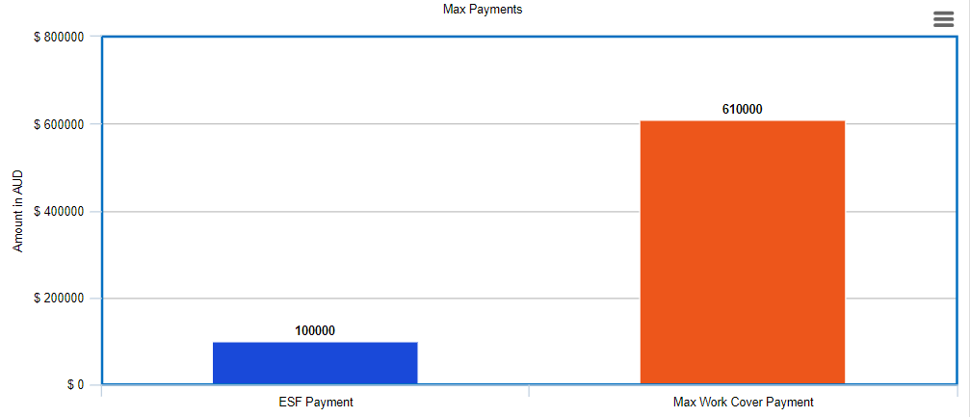
Assistance Payments in last 15 years
Notes:
Maximum of 10k (limit raised to this in 2010’s)
Families receive the check from the organization they were from
Served to lighten the load immediately following tragedy - introduce changes? (2 income households, legislature, etc.)
Originally intended for upfront necessities like funerals/travel for families
Payments are immediate following tragedy
No questions asked - no need for lengthy investigations/approval processes
Manasi
Compare how the ESF’s $2000 donation is nothing compared to other support in place, max work cover is around $611,000, ESF hasn’t even contributed ⅓ that amount in 15 years

Slide 9
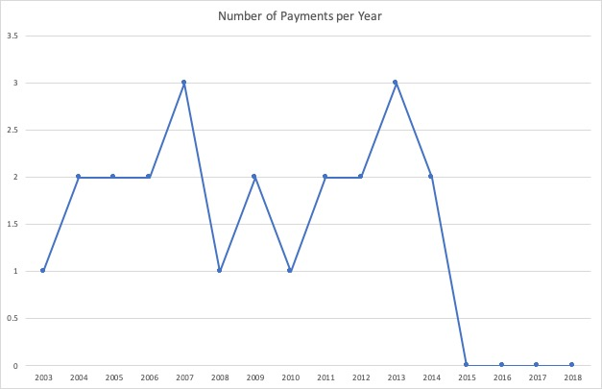
Payments by ESF in last 15 years
Notes:
Manasi
Something like “as you can see there have been no payments since 2014 and even before that some years were scarce”
This graph points to why this study was undertaken because the paymetns over the past few years diminished

Slide 10
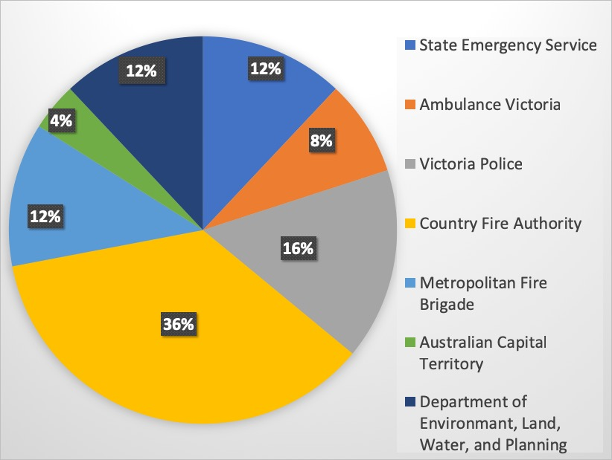
Payments in last 15 years by agency
Notes:
Manasi
Police- Number of things in place: Police Legacy

Slide 11
ESF Relief and Assistance Payment Conclusion
ESF payments are no longer necessary…
Notes:
Manasi
Siusan wants just “payments are no longer necessary” as only text on this slide
Make sure to verbalize “there is no longer a place for the ESF’s payments”

Slide 12
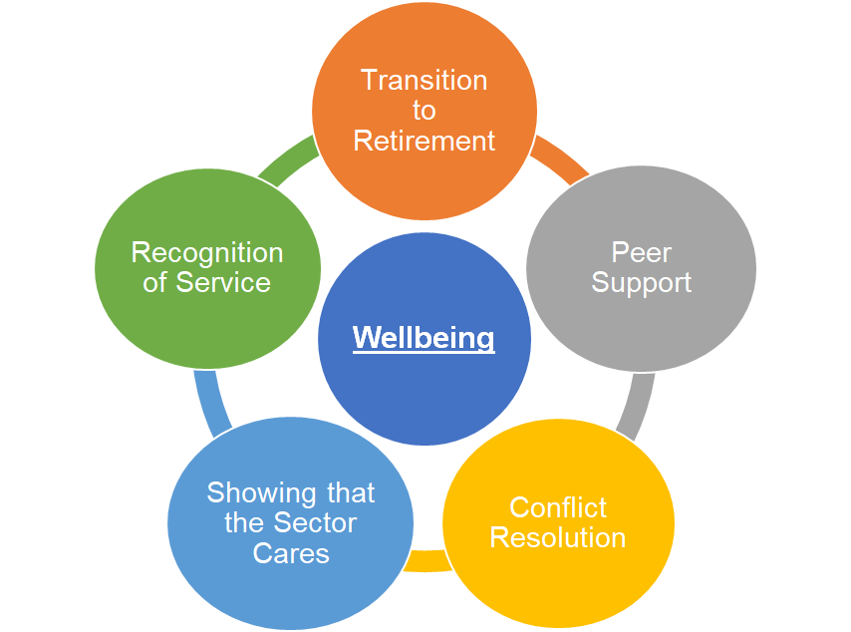
ESF Relief and Assistance Payment Conclusion
Notes:
Manasi
Siusan wants just “payments are no longer necessary” as only text on this slide
Make sure to verbalize “there is no longer a place for the ESF’s payments”

Slide 13
Transition to Retirement
Average age of workers across agencies is 45-55
Few agencies have programs in place that cover holistic transition to retirement
Opportunity for best practice across the sector
Need to talk to people who have retired and who are about to retire to identify concerns and needs
Notes:
Andrew
Few agencies doing it
Agencies that have them aren’t holistic.. All financial

Slide 14
Conflict Resolution
While this may not be applicable for large organizations, the smaller organizations find this to be helpful
Conflict within brigade or unit has potential to destroy community cohesion
Some agencies use organizations such as IBAC or VCAT
Opportunity for an independent, non-biased 3rd party available for mediation or appeal
Between colleagues
Between colleagues and management
Notes:
James
“In beyond blue’s research they pointed to the impact of workplace conflict on mental health and well being”

Slide 15
Recognition
People need to know they are valued by community, organization, and team
This is done inconsistently and not as a sector at community level
Opportunity for ESF to lead a recognition campaign
Possibly host a scalable, family-friendly, multi-agency event to recognize those who responded to major incidents with corporate support
Showcase emergency management multi-agency capability to inform public and make those working in sector proud
Notes:
James
“We have realized through our conversations that recognition is huge and people need to know___, but this done ___”
“It appears that this is done inconsistently and NOT as a sector”
Recognizes workers and informs public about what they do

Slide 16
Showing that the Sector Cares
Cheques were a token to show that the sector cares
United Services Organization runs a care package system for recently bereaved families
Package includes comfort items, books of support, personal notes, and information from the sector
Opportunity for the ESF to explore what a comfort kit might look like here
Notes:
James
“Through our conversations we realized that the value of the ESF’s cheques have diminished over time, however we believe there are other ways to show that the sector cares. One method that we have found through our research is the USO____”

Slide 17
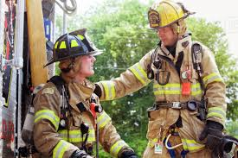
Types of Support
Inconsistent
Are You Ok?
Professional Support: EAP
Brigade-Level Support
Peer Support
Notes:
Manasi
Emergency service picture in middle

Slide 18
Peer Support
Every organization recognizes the importance of peer support
Current peer support systems across the sector differ
Vary from very little training and screening to very extensive processes
Opportunity for a best practice sector-wide protocol that would allow agencies to create a consistent approach to peer support
Notes:
Manasi
CFA is reviewing peer support- only one agency doing it

Slide 19
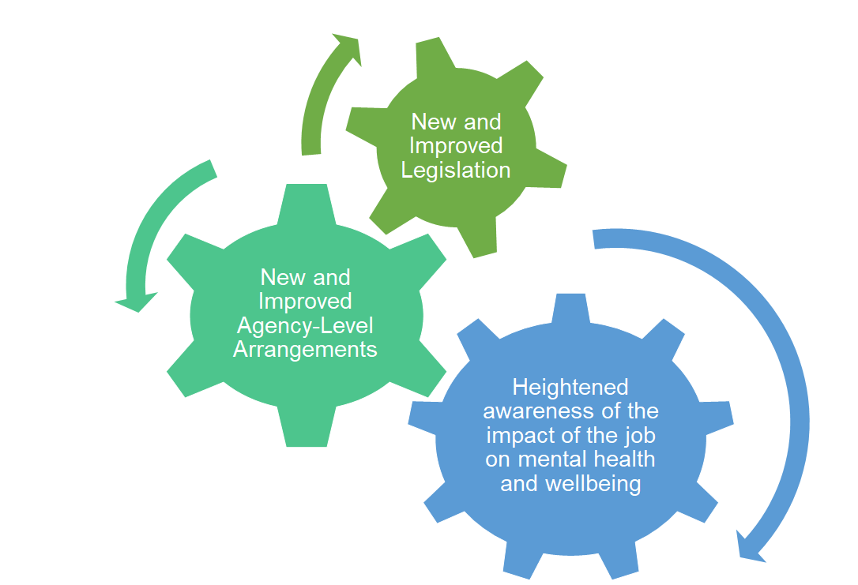
Conclusion and Summary of Findings
•ensures financial compensation for both paid and volunteer workers – far bigger payments than what ESF can offer
•provide immediate cash payments and funerals for people killed in the line of duty
Notes:
There's been a real shift to an awareness around mental well being and our research has pointed us to having the organization focus on wellbeing
Andrew
When we spoke to agencies, these key areas kept coming up

Slide 20
Conclusion and Recommendations
~ 1980s
~ 2018
The ESF was founded to provide families with an immediate cash payment to cover the cost of funerals and pay some bills. This was a need identified by the review into the Ash Wednesday fires.
Transition to retirement
Recognition of service
Showing that the sector cares
Conflict resolution
Peer Support
Opportunity to fill gaps.
Notes:
There's been a real shift to an awareness around mental well being and our research has pointed us to having the organization focus on wellbeing
Andrew
When we spoke to agencies, these key areas kept coming up

Slide 21
Thank You
Notes:
- ryan
- we need to explain an IQP here
-explain WPI

Slide 22
ESF Relief and Assistance Payment Conclusion
Notes:
Manasi
Siusan wants just “payments are no longer necessary” as only text on this slide
Make sure to verbalize “there is no longer a place for the ESF’s payments”

